Slide 1
Web Scraping with Python
Extracting Latest Python Articles from Python.org

Slide 2
Web scraping
Web scraping, web harvesting, or web data extraction is data scraping used for extracting data from websites.
Web scraping software may directly access the World Wide Web using the Hypertext Transfer Protocol or a web browser.
We can use web scraping for several reason like Data Collection and Aggregation, Market Research, Financial Analysis etc.

Slide 3
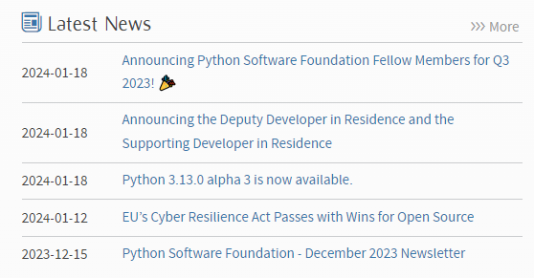
Why we use web scraping?
We are using web scraping for getting latest news from https://www.python.org/.
In this code we are using function fetching the latest Python articles.
We can web scraping with the “get_latest_python_articles” function, URL, and BeautifulSoup, request usage.

Slide 4
Using library and code
Web Scraping with BeautifulSoup:
Making a GET request to the specified URL using the requests library.
Creating a BeautifulSoup object to parse the HTML content obtained from the GET request. “soup = BeautifulSoup(response.text, 'html.parser')”
Executing the code in the “__main__” block, calling the “get_latest_python_articles” function, and displaying the retrieved articles.

Slide 5
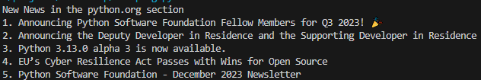
output
When we are run the code showing the latest article in python.org.

Slide 6
How to work the beautifulsoup?
We are requesting with request for making HTTP requests and BeautifulSoup (BS4) for web scraping.
Making the request with response = requests.get(url).
Checking the status code with “if response.status_code == 200”
If the request is successful, the HTML content is parsed using soup = BeautifulSoup(response.text, 'html.parser')
In the __main__ block: The get_latest_python_articles function is called, and the retrieved articles are stored in the python articles variable.

Slide 7
Conclusion
The code serves the purpose of automating the retrieval of the latest Python articles from the Python.org website, providing a quick overview of the recent updates in the Python community.

